Slide 1

Project Pitch
V-OAR
INTstigators

Slide 2

James Farrell
Project Lead [Main]
VR Development
Sound Design
Level Scripting [Secondary-Aid]
Keelan Murphy
3D Modelling [Main]
3D Animation
Texture Design
UI Design [Secondary-Aid]
Nathan Hill
Scrum Master [Main]
Game Design
UI Design
Sound Design [Secondary-Aid]
Kristine Saroka
Level Scripting [Main]
Level Design
Testing
VR Development and UI Design [Secondary-Aid]
Our Team

Slide 3





Technologies
Notes:
It provides a large file storage system (LFS) which allows us to upload Unity scene files.

Slide 4
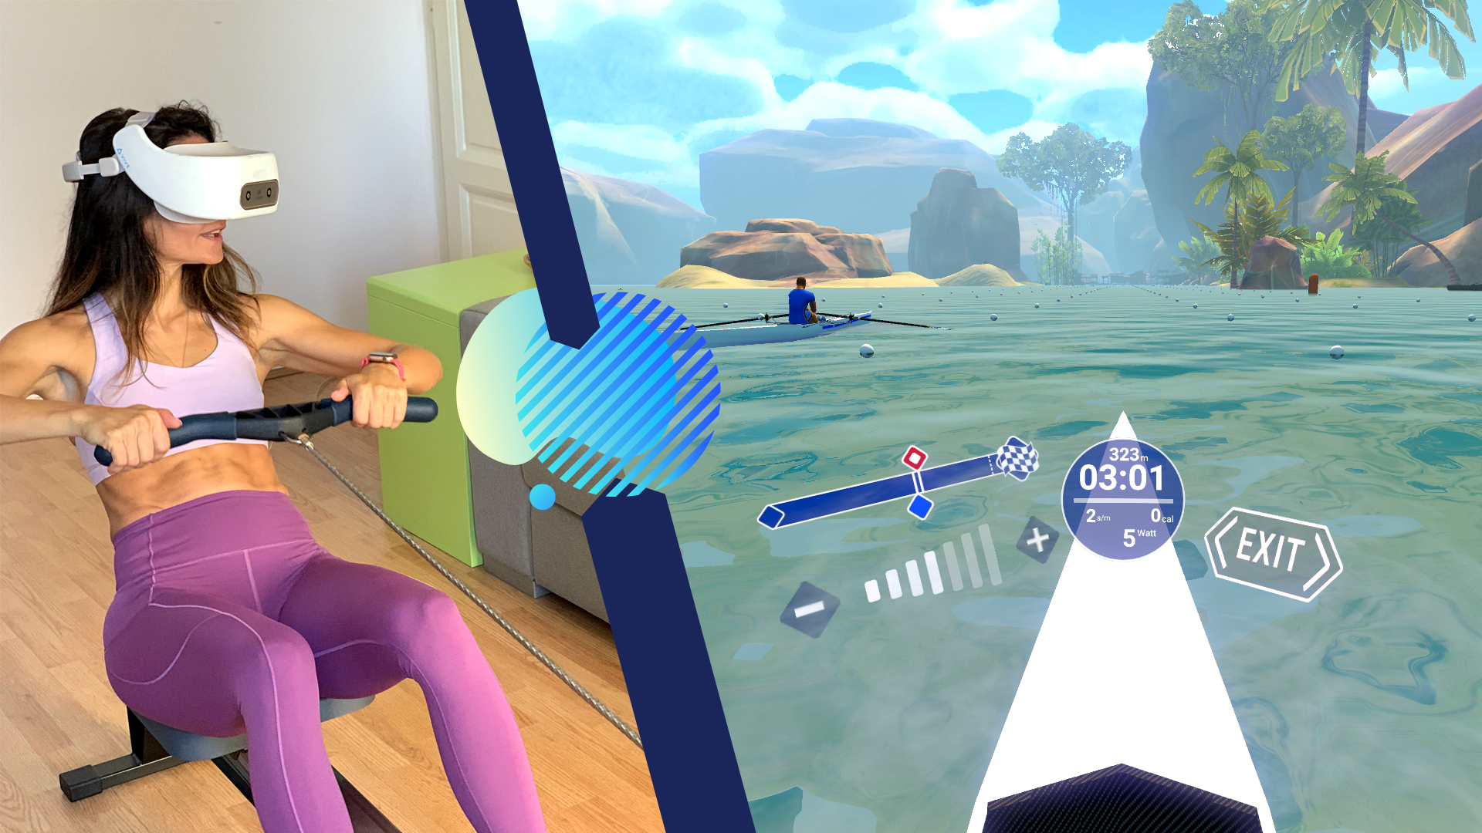
V-OAR is a virtual reality rowing experience, which transforms a typical workout into explorations of an open world
Game Idea
Combining virtual reality with physical interactions

Slide 5


Target Group
Frequent and experienced rowers, who work out alone or as part of a team.
Demographic
Objective
Improve the existing experience of our target users, by providing them with a solution that is more engaging and interactive than a traditional rowing machine.

Slide 6
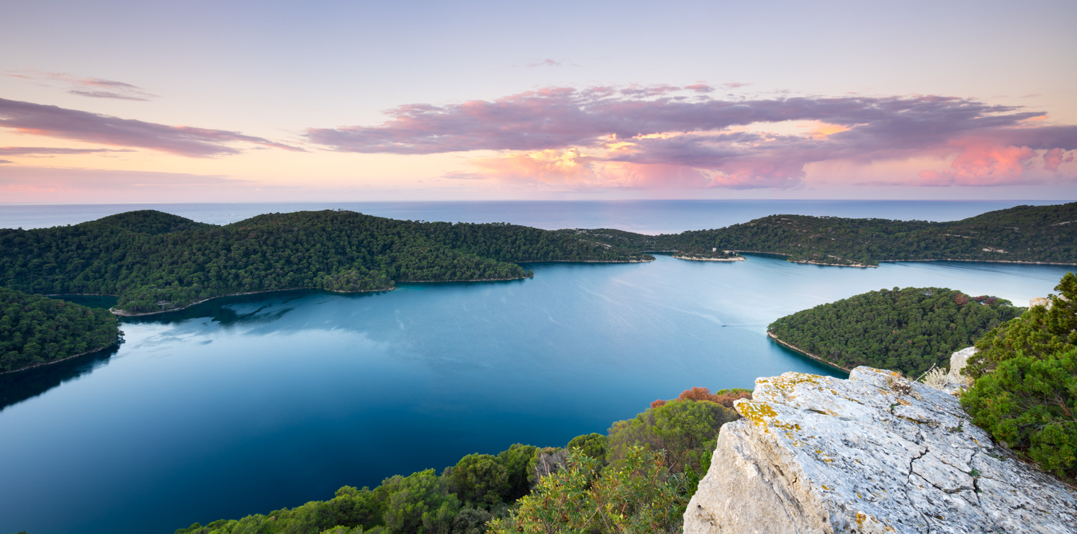
Exploratory Mode
Player explores an open-world lake with various hubs linking to our training modes.
Modes &
Mechanics
Exploratory
Training
Time Trials
Race
Objective
To provide a relaxing environment for the player to explore.

Slide 7
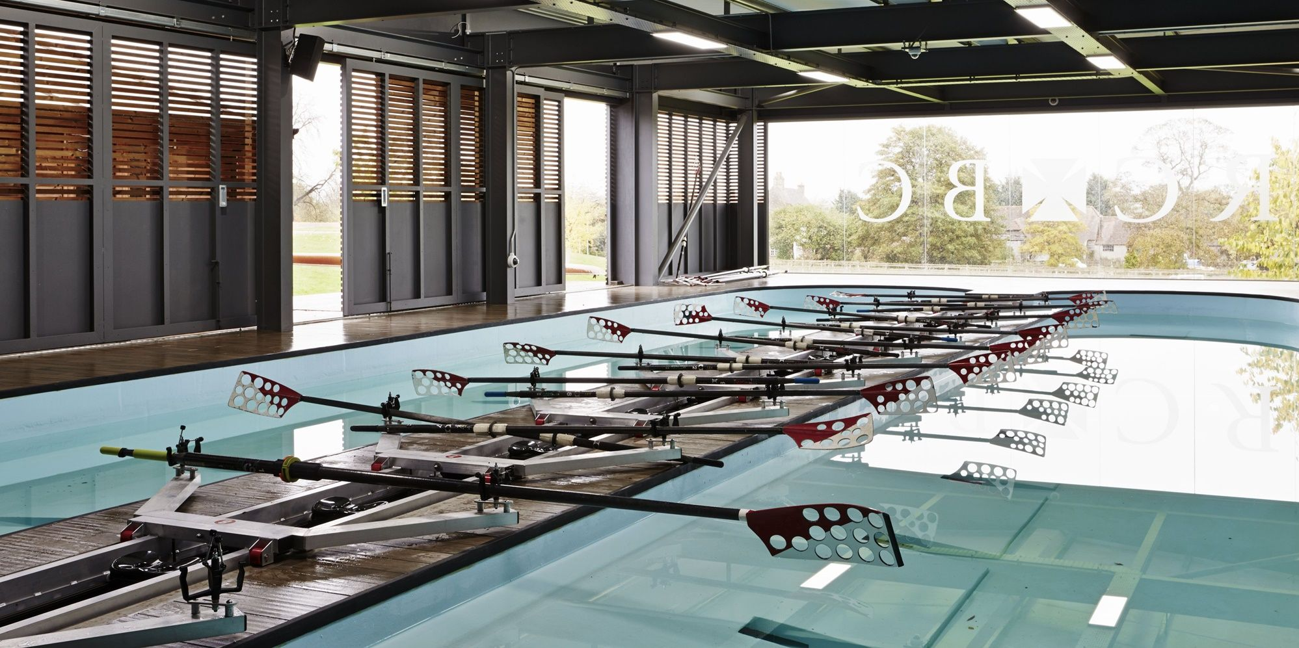
Training Mode
Player rows a stationary boat, while a virtual coach encourages them.
Modes &
Mechanics
Exploratory
Training
Time Trials
Race
Objective
To provide a virtual training environment which allows the player to enhance their skills.

Slide 8
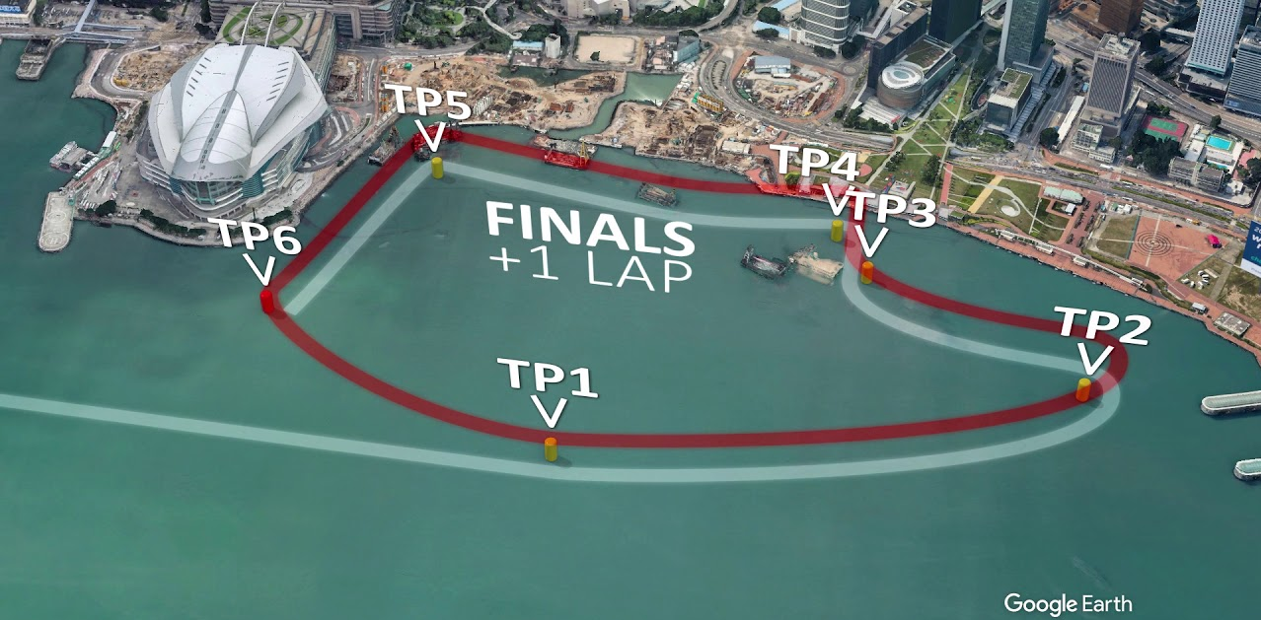
Time Trials Mode
Player attempts to beat their previous best time around a short, pre-set course.
Modes &
Mechanics
Exploratory
Training
Time Trials
Race
Objective
To provide a challenging environment which motivates the player to improve their performance.

Slide 9
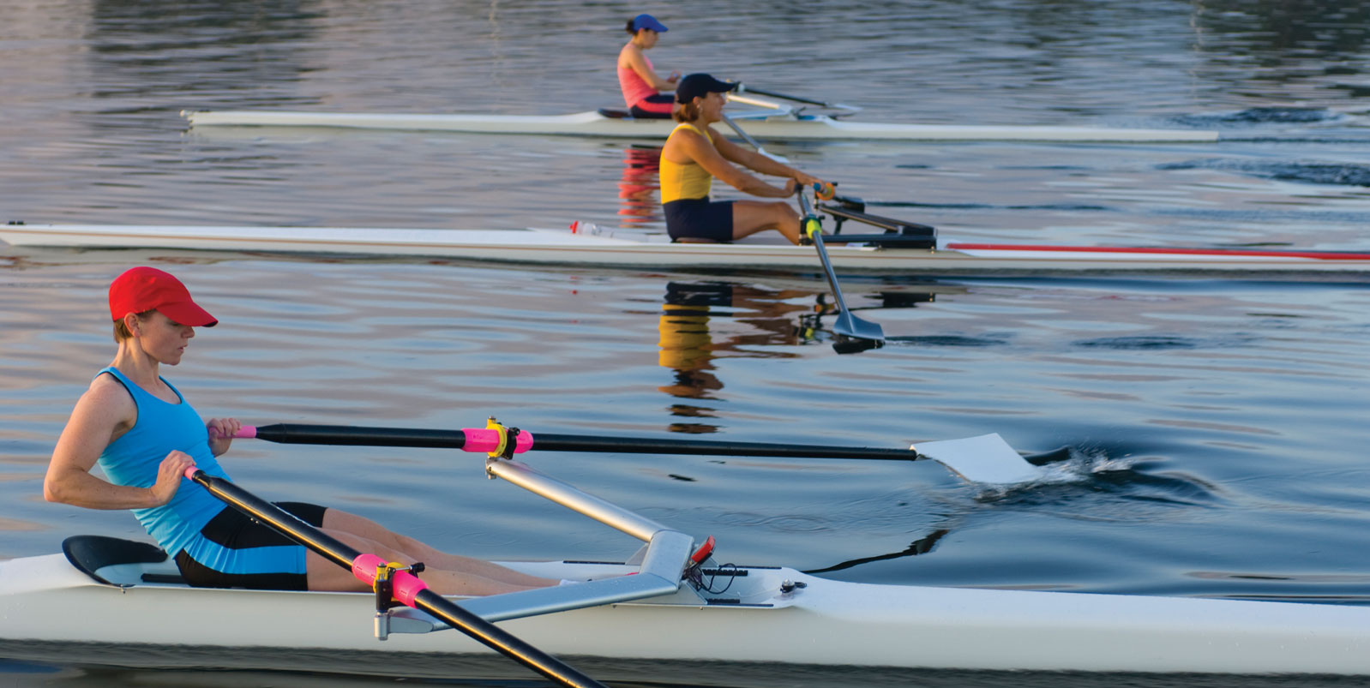
Race Mode
Player goes head-to-head against an AI competitor across a 500-meter sprint.
Modes &
Mechanics
Exploratory
Training
Time Trials
Race
Objective
To allow the player to test their training in a virtual competition.

Slide 10
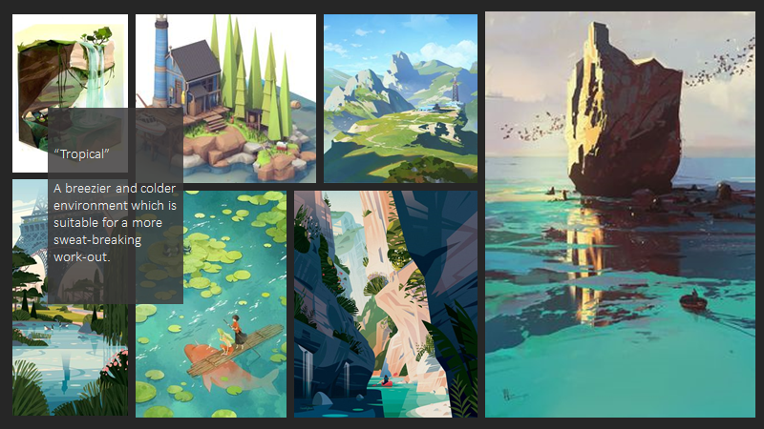
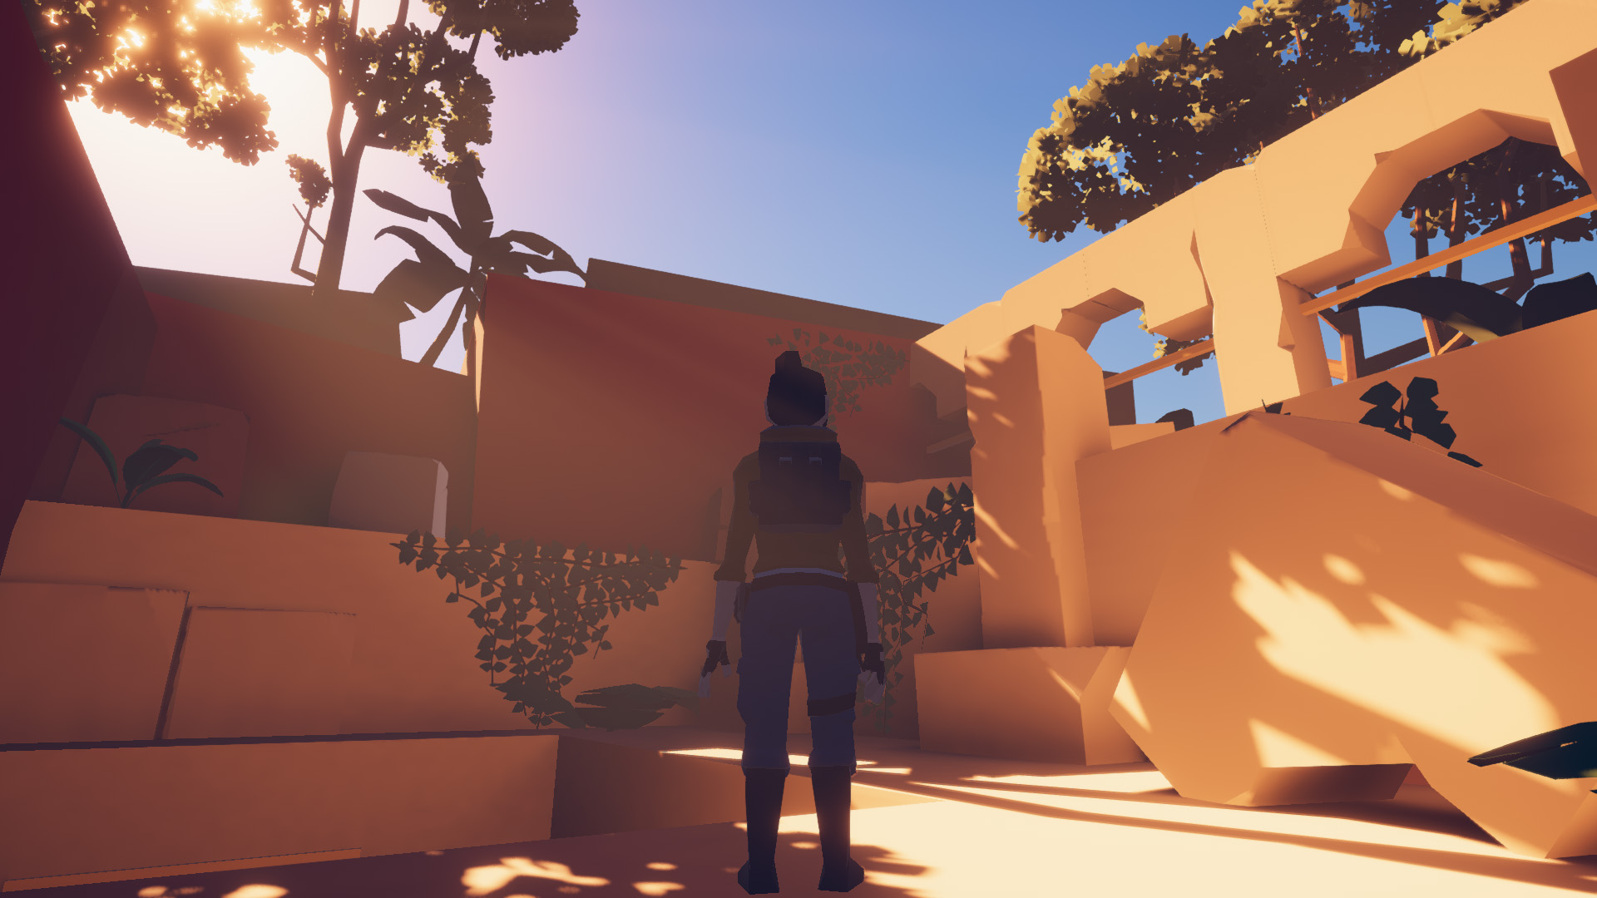
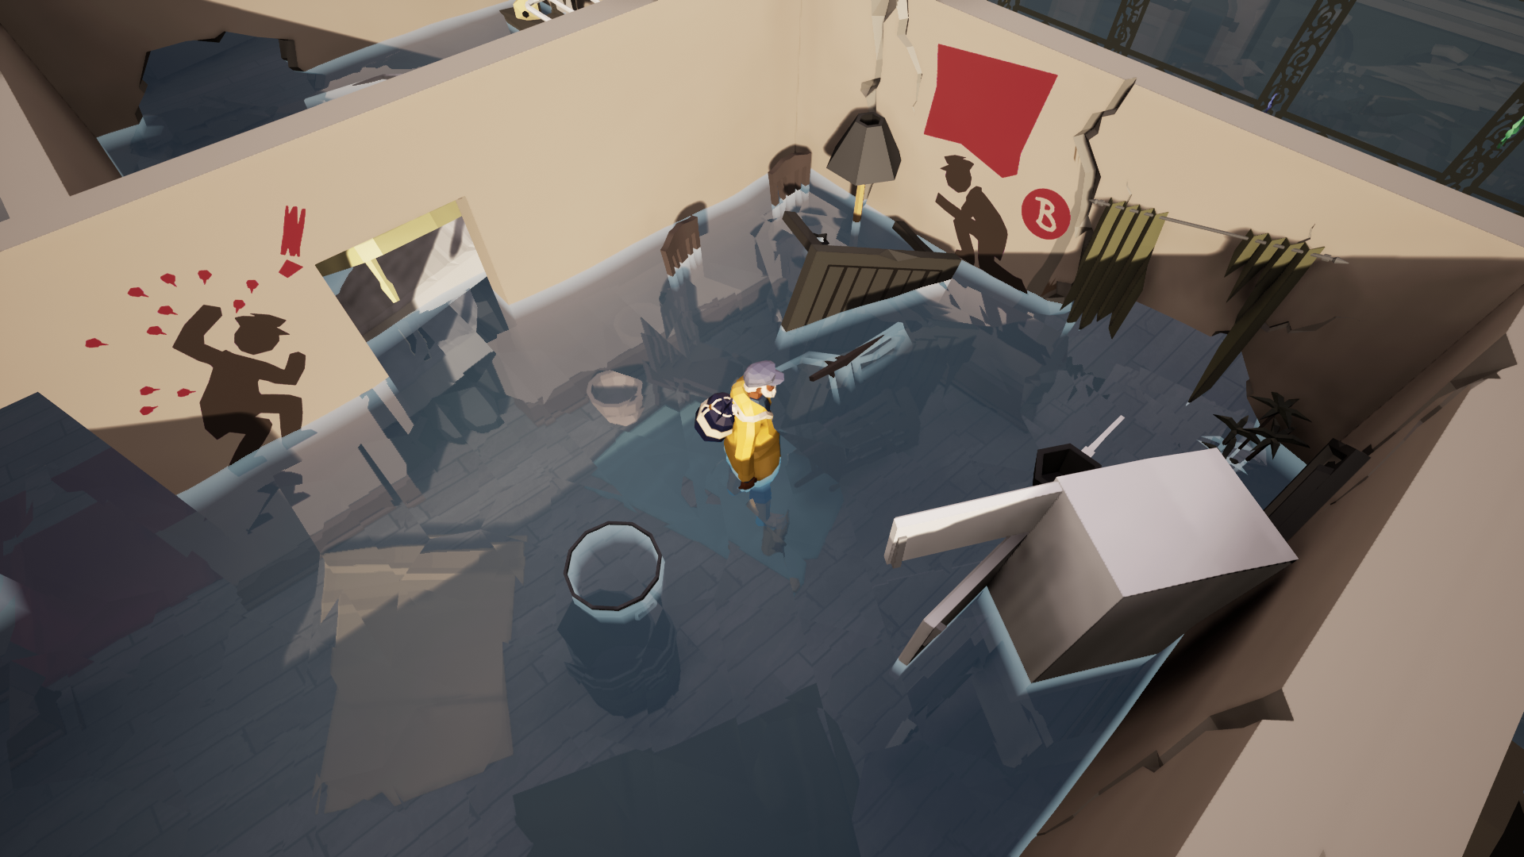
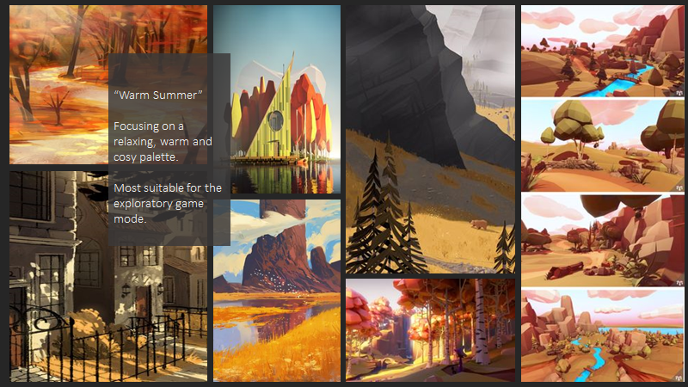
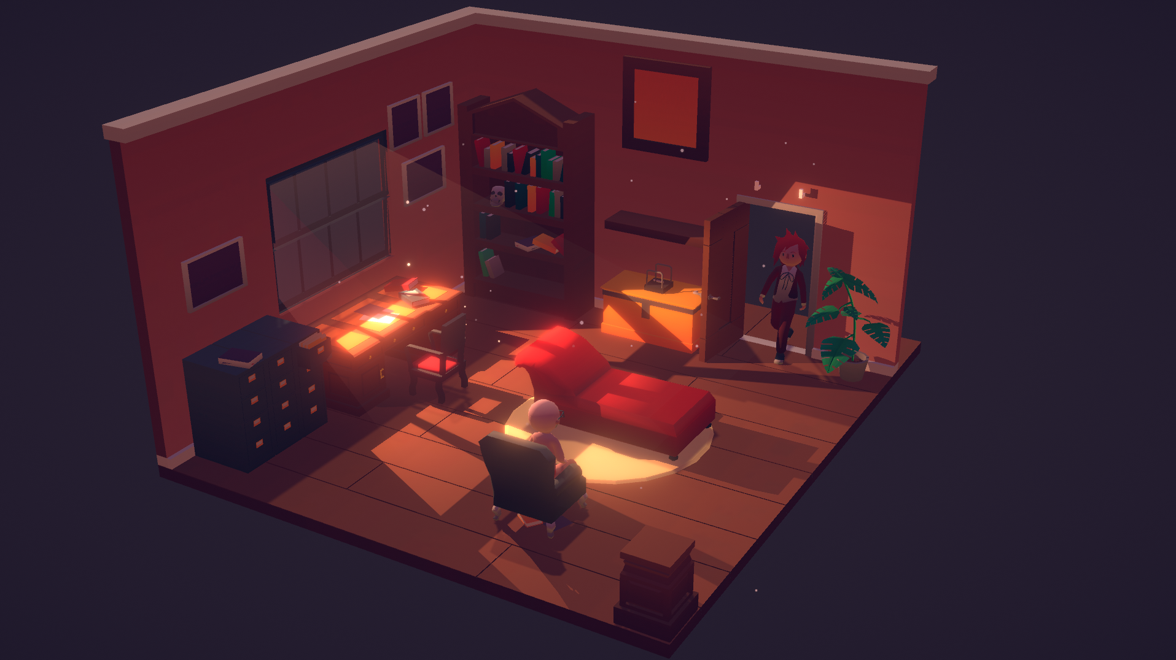
Visuals
Minimal Raider (hedgefield)
Low-Poly
Base Colours
Dual Environment
Hot & Cold Biome
Colour Palettes
Lost in Tide (ArtFX School)
[Dr Emoji] (Vainary)

